Slide 1
AWS Overview
Data Analytics

Slide 2


Cloud Computing
Not this
This

Slide 3

Amazon Web Services (AWS)
Amazon Web Services (AWS) is an on-demand cloud computing platform that offers many different tools and solutions for individuals, organizations, analysts, and developers. AWS is used across data centers in over 180 countries. Organizations and groups such as government agencies, educational institutions, nonprofits, and private organizations can use AWS. As a Data Analyst you will learn how cloud services work to better serve your users and organizations.
Other cloud companies/services include
Microsoft Azure
Google Cloud
Salesforce

Slide 4


Early AWS
Simple Storage Solution (S3)
Elastic Cloud Compute EC2

Slide 5


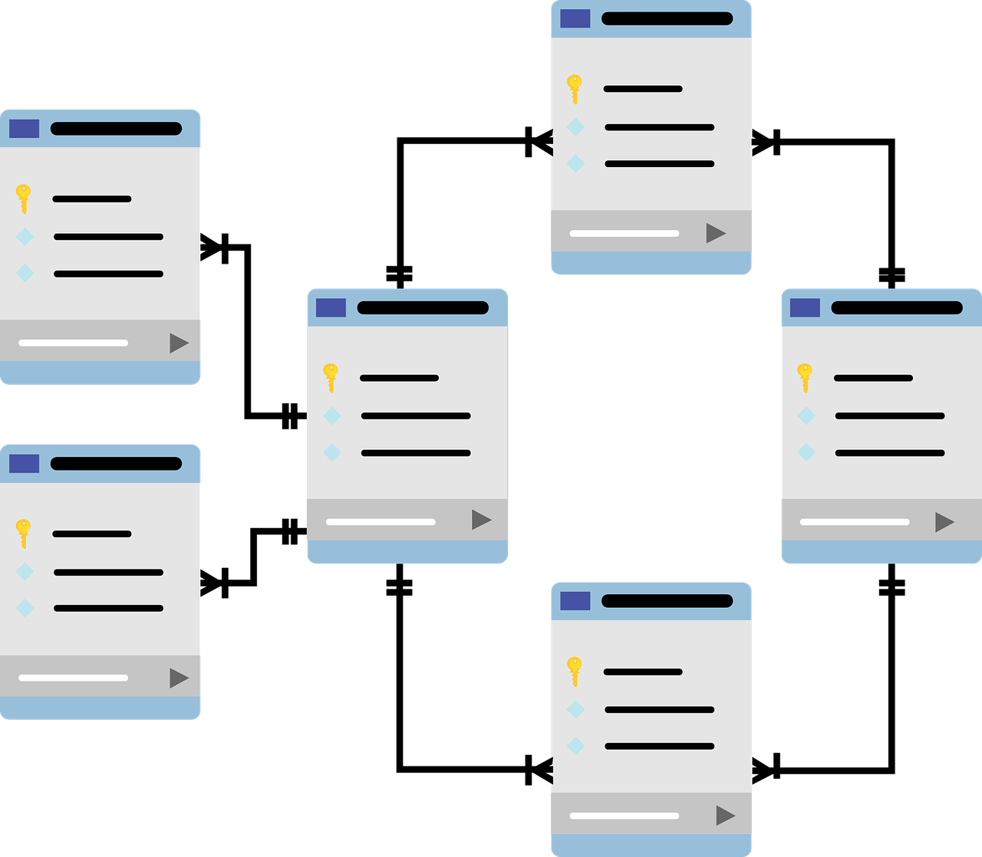
Extract, Transform, Load

Slide 6


Data Warehouse
CRM
Extract
ERP
Extract
Transform
Load
SCM
Extract
Datamarts

Slide 7







Enterprise Cloud Computing
NoSQL
Streaming
Data
ETL
ETL
S3 Data Lake
ETL
ETL
Machine
Learning
ETL
ETL
ETL
Data
Warehouse
ETL
RDBMS
(SQL)
Analytics

Slide 8
Enterprise Data Use Cases
A business analyst wants to create a chart of sales and profit for the past 2 quarters
A product manager wants to know how many furniture products have been left in customer shopping carts for more than 24 hours
A marketing manager wants to know what topics are trending this week
A sales manager wants to know how many customers visit the web site more than 5 times but don’t purchase anything
A warehouse manager wants to know how long it took for customers to receive their orders in the past year

Slide 9



Data Governance
+
+
People
Policy
Service

Slide 10
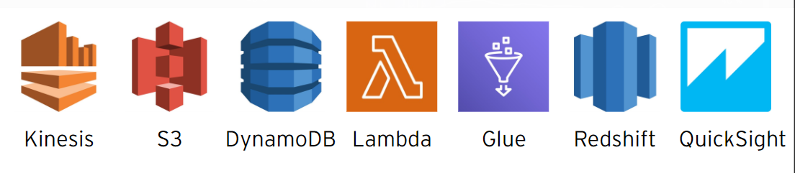
AWS Analytic Services
AWS can be personalized to cater to each organization
- data collection – AWS Kinesis
- data storage – AWS S3 / DynamoDB
- data processing – AWS Lambda / AWS Glue
- data analysis – AWS Redshift
- data visualizations – AWS QuickSight

Slide 11




Relational Database Service
Amazon Relational Database Service is a distributed relational database service by Amazon Web Services. It is a web service running "in the cloud" designed to simplify the setup, operation, and scaling of a relational database for use in applications.

Slide 12

AWS S3 – Simple Storage Solution
Amazon S3 (Simple Storage Solution) houses a web (cloud) storage interface that users can use to store and retrieve any amount of data. As an analyst, you at any time, from anywhere on the web can access the same highly scalable, reliable, fast, data storage. The data storage in S3 creates what are called buckets. Then you have objects that consist of data. The data is assigned a key (assigned name) and metadata. Buckets are used to store objects. When data is added to a bucket, Amazon S3 will then create a unique identifier and gives it to the object.

Slide 13

AWS DynamoDB – Simple Storage Solution
Amazon DynamoDB is a No SQL database that offers reliable performance and simple APIs for key-value access as well as advanced query patterns. DynamoDB is good with working with large amounts of data, JOINS, advanced SQL and has latency (time delay) size up to over 100 TBs! If you want to generate recommendations to your audience, DynamoDB provides simple access patterns to make your findings fast and reliable.

Slide 14

AWS Glue – Data Processing
AWS Glue is a serverless data integration system that will make it easy for you to discover, prepare, and combine data to perform your analysis or machine learning. Glue gives you all you need to integrate data do you can start analyzing the data and putting it to use in just moments. AWS Glue has a data catalog that houses all your user’s metadata. Glue will give you the capability to compute statistics and maintain large data, so you can understand how it is constantly changing. Using Glue, you can visually transform your data, using drag and drop features. From there, Glue will generate code that can be written and reused on demand or a case-by-case basis.
Blah Blah Blah .. it’s an ETL tool

Slide 15

AWS Redshift – Data Analysis
AWS Redshift gives you fast querying capabilities over structured data using familiar SQL-based clients and business intelligence (BI) tools using standard ODBC and JDBC connections. Your queries are distributed and accessible in the AWS Redshift console. Redshift automatically covers and backs up your data warehouse, storing the backups for a user-defined retention period.
Blah blah blah ..
It’s a data warehouse

Slide 16

AWS Kinesis – Data Collection
Amazon Kinesis will make it easy for you to collect, process, and analyze real-time, streaming data. You can get timely insights, allowing you to react quickly to new information. Amazon Kinesis offers you key capabilities to process streaming data at any scale. The flexibility of this data collection service gives you access to the best tools to ingest real-time data. Real-time data such as video, audio, machine learning, analytics, and much more. Amazon Kinesis gives you the ability to process your data, analyze your data, and respond quickly to your users.

Slide 17

AWS QuickSight – Data Visualization
AWS QuickSight is a cloud-scale BI service that you as an analyst will use to deliver easy-to-understand insights to the people who you work with or users. QuickSight has the ability to connect to your data in the cloud. From there, is combines your data from many different sources. You can see all your data in a single dashboard where it be big data, spreadsheet data, global data, etc. QuickSight gives you the tools you need to create strong visuals to help give your decision-makers the opportunity to explore and interpret information in an interactive visual environment. Users who have access, can view secured dashboards from any device or network.
Blah blah blah …
It’s a Tableau knockoff

Slide 18

Simple Storage Solution (S3)
Creating buckets – create and name buckets that store your data. Buckets are the fundamental containers in Amazon S3 for data storage.
Storing data – using S3 you can store unlimited amounts of data in a bucket. Each object is stored and recalled using a unique developer-assigned key.
Downloading data – using S3 you can also download your data at any time and enable users to do the same.
Permissions – you can also set access to others who want to upload or download data into your S3 bucket. You can grant upload and download permission to up to three types of users.

Slide 19
Buckets
Buckets
Buckets organize the Amazon S3 namespace at the highest level.
They identify the account responsible for storage and data transfer charges.
They play a role in access control.
They serve as the unit of aggregation for usage reporting.
You can configure buckets so that they are created in a specific AWS Region.
Versioning keeps multiple variants of objects in the same bucket.
Once you enable versioning for a bucket, S3 will store all of those objects

Slide 20
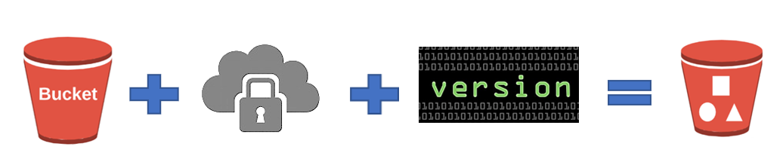
Objects
To access objects, you will first need to know the bucket that contains the object data.
Two ways to work with objects:
Open - lets you open the object details in another window. You will want to make sure that you have the desired object checked. You can select more than one at a time.
Delete - lets you delete the object. When you go to delete objects you will get reminders on what will happen to the objects and specified folders.

